Slide 1

Database Maintenance Essentials
Steve Jones
Editor, SQLServerCentral
Red Gate Software
Notes:
Start up SSMS, load trace def
Start SQL Storage Compress
Start SQL Monitor (tabs for overview, config, custom alerts)
Start SQL Index Manager
Start Windows Manager and go to: D:\Program Files\Microsoft SQL Server\MSSQL11.MSSQLSERVER\MSSQL\DATA
Start Profiler, stopped Tuning trace
Start DTA

Slide 2

What We Are Going to Learn Today
Managing MDF and LDF Files
Managing Indexes
Maintaining Statistics
Checking for Corruption
Creating Backups That Will Restore
Managing Maintenance Jobs
Not every recommendation may be appropriate for your environment. Be sure to test in a non-production environment before trying these recommendations out.
Notes:
Mention that I will be discussing, in addition to these best practices, some of the tools available from Red Gate that can help you out.

Slide 3
What We Are Going to Learn Today
Managing MDF and LDF Files
Managing Indexes
Maintaining Statistics
Checking for Corruption
Creating Backups That Will Restore
Managing Maintenance Jobs
Not every recommendation may be appropriate for your environment. Be sure to test in a non-production environment before trying these recommendations out.
Notes:
Mention that I will be discussing, in addition to these best practices, some of the tools available from Red Gate that can help you out.

Slide 4
Managing MDF & LDF Files
There is a myth that MDF and LDF files “manage” themselves.
In reality, for optimal performance, DBAs must take full responsibility for managing them, as we will see in the next few slides.

Slide 5
Create a database
Sales.mdf – 2MB
Sales.ldf – 1MB

Slide 6
Autogrow
Sales.mdf – 2MB
Sales.ldf – 100MB

Slide 7
Autogrow
Sales.mdf – 50MB
Sales.ldf – 100MB

Slide 8
Autogrow
Sales.mdf – 50MB
Sales.ldf – 200MB

Slide 9
Autogrow
Sales.mdf – 50MB
Sales.ldf – 300MB

Slide 10
Autogrow
Sales.mdf – 100MB
Sales.ldf – 300MB

Slide 11
Autogrow
Sales.mdf – 100MB
Sales.ldf – 400MB

Slide 12
Autogrow
Sales.mdf – 100MB
Sales.ldf – 600MB

Slide 13
Autogrow
Sales.mdf – 100MB
Sales.ldf – 800MB

Slide 14
Autogrow
Sales.mdf – 200MB
Sales.ldf – 800MB

Slide 15
Autogrow
Sales.mdf – 200MB
Sales.ldf – 1GB

Slide 16
Autogrow
Sales.mdf – 20GB
Sales.ldf – 1GB

Slide 17
Autogrow
Sales.mdf – 100GB
Sales.ldf – 4GB

Slide 18
Autogrow - Fragmented
Sales.mdf – 200GB
Sales.ldf – 120GB

Slide 19
The Disk

Slide 20
The Disk

Slide 21
The Disk

Slide 22
The Disk

Slide 23
The Disk

Slide 24
The Disk

Slide 25
The Disk

Slide 26
The Disk

Slide 27
The Disk

Slide 28
The Disk - Fragmented

Slide 29
Managing MDF Files
Pre-size for xx months (I recommend 4-6 months)
Free space inside the mdf/ndf is not bad.
Monitor file sizes and data growth
When you need space, manually grow the files
If you overestimated the database’s size, that’s not a problem either. Don’t shrink the database*.
Don’t depend on Autogrow
* If you are wildly oversized, shrink once to meet the needs for the next quarter
Notes:
Benefits are explained on next slide.

Slide 30
Manually Grown
Sales.mdf – 200GB
Sales.ldf – 120GB

Slide 31
Managing LDF Files
Pre-size
The size should be the peak amount of log data between log backups + a pad
Monitor and adjust the size as needed over time. Grow the file by 8000MB *
A guesstimate is better than letting autogrowth grow the LDF file for you.
Multiple files do not help performance
* http://sqlskills.com/BLOGS/KIMBERLY/post/Transaction-Log-VLFs-too-many-or-too-few.aspx

Slide 32
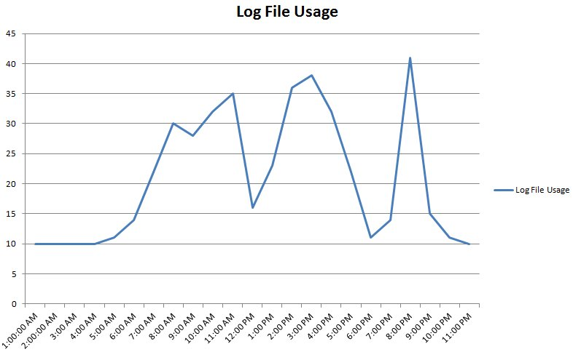
Managing LDF Files

Slide 33
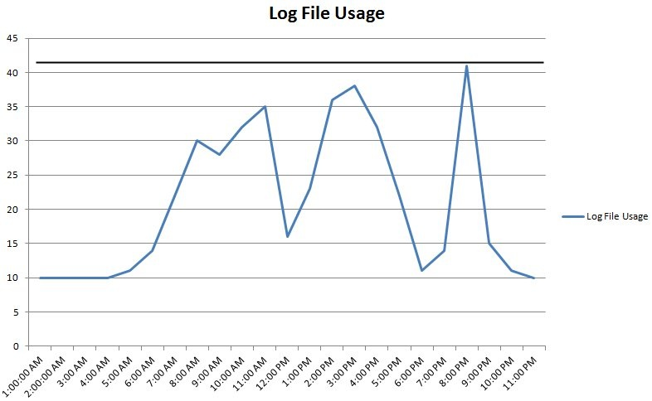
Managing LDF Files

Slide 34
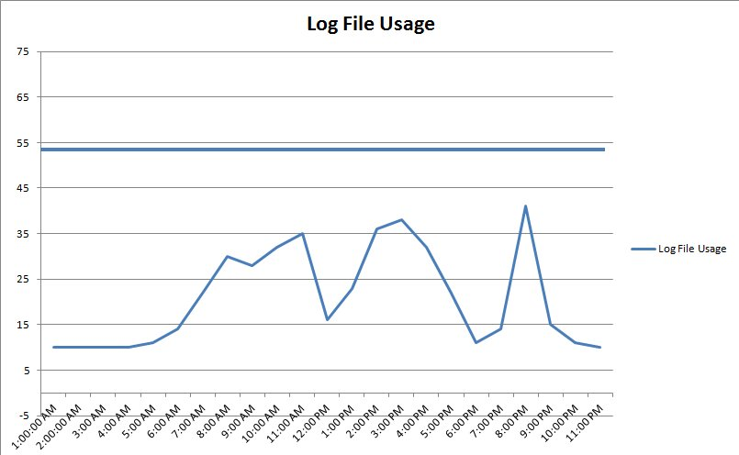
Managing LDF Files

Slide 35
Database Files – Data and Log
DO NOT depend on Autogrow.
This is for emergencies
Monitor, monitor, monitor
Use alerting to let you know when space is low.
Keep free space in the files

Slide 36
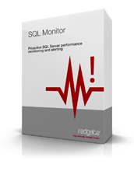
Using SQL Monitor to Help You Out Managing MDF and LDF Files
Find disk sizes and available space
File size information (database level)
Disk space alerts
Performance Monitor Counters
Create a custom metric
Demo
Notes:
Demo – Show SQL Monitor
- Find disk sizes on main page
Show alerts
counters
- custom metric (database growth)

Slide 37
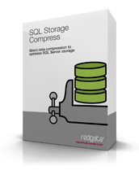
Using SQL Storage Compress to Reduce Your Storage Footprint
Running out of disk space?
SQL Storage Compress can compress databases up to 90% (with an average 73%).
SQL Server doesn’t even know SQL Storage Compress is being used.
Great for compressing copies of your databases
Demo
Notes:
Show AdventureWorks large in storage compress and in SSMS showing actual size on disk and what SQL Server sees.

Slide 38
What We Are Going to Learn Today
Managing MDF and LDF Files
Managing Indexes
Maintaining Statistics
Checking for Corruption
Creating Backups That Will Restore
Managing Maintenance Jobs
Not every recommendation may be appropriate for your environment. Be sure to test in a non-production environment before trying these recommendations out.
Notes:
Mention that I will be discussing, in addition to these best practices, some of the tools available from Red Gate that can help you out.

Slide 39
Regularly Review Indexing Needs
Indexing Needs Change
Data volume
The queries
Your indexing scheme may need to be changed to keep up with the data and data usage changes.
For examples, indexes may need to be added, modified, or removed for optimal query performance.
Proactively monitor your servers to see if their indexing needs are properly met. SQL Server will not do this for you.
Notes:
Now let’s drill down into more detail about maintaining indexes.

Slide 40
Identify Missing Indexes
One way to identify missing indexes is to use a SQL Trace to capture a trace file, and then use the Database Engine Tuning Advisor (DTA) to analyze the trace to look for index recommendations.
When capturing a SQL Trace, use the Tuning template and capture data over a representative time frame.
Run the DTA against the trace data, review recommendations, and then add appropriate indexes. Do so regularly, as dictated by needs.
Note: you can use sys.dm_db_missing_index_details to help identify missing indexes, but it has many limitations, and I don’t recommend using its recommendations unless you really know what you are doing.

Slide 41
Identify Unused Indexes
Most databases have one or more indexes that were created because they seemed that they might be useful, but they have ended up not being used.
Because indexes need to be maintained when data changes in a table, maintaining indexes that are not used are a waste of resources.
Periodically, identify unused indexes and remove them.
Use the sys.dm_db_index_usage_stats DMV to help you identify unused indexes.
* The data in this DMV is cleared out each time SQL Server is restarted

Slide 42
Identify Duplicate Indexes
For many different reasons, it is possible for the duplicate indexes to be created using different names.
This wastes resources and duplicate indexes should almost always be removed.
See the following URLs for sample scripts:
www.sqlblog.com/blogs/paul_nielsen/archive/2008/06/25/find-duplicate-indexes.aspx
http://blogs.msdn.com/b/mssqlisv/archive/2007/06/29/detecting-overlapping-indexes-in-sql-server-2005.aspx
http://www.sqlskills.com/BLOGS/KIMBERLY/post/RemovingDuplicateIndexes.aspx

Slide 43
Index Maintenance: Fragmentation
Index Fragmentation Hurts Performance
Over time, as indexes are subjected to data modifications, gaps in data on pages develop (internal fragmentation), and the logical ordering of the data no longer matches the physical ordering of the data (external fragmentation). Together, this is referred to as index fragmentation. This is a normal behavior, but must be regularly addressed.
Heavily fragmented indexes can lead to poor query performance, especially if scans occur regularly. This is because less data can fit into the data cache and because more disk I/O is required.
Because of this, it is important that DBAs regularly detect and remove index fragmentation from their databases on a regular basis.

Slide 44
Index Fragmentation Maintenance
There are three ways to remove fragmentation from an index:
Reorganize: online (Standard and Enterprise Edition)
Rebuild: offline (Standard and Enterprise Edition)
Rebuild: online (Enterprise Edition Only)
Each option has its pros and cons. You must select the option(s) which work best for your environment. I can’t tell you what will work best for your environment.

Slide 45
Rebuild Indexes
A
H
E
B
G
C
D
F
J
I

Slide 46
Rebuild Indexes
A
H
E
B
G
C
D
F
J
I

Slide 47
Rebuild Indexes
A
H
X
E
B
Z
G
Y
C
D
X
F
J
I

Slide 48
Rebuild Indexes
A
H
X
E
B
Z
G
Y
C
D
X
F
J
I
A
B
C
D
E
F
G
H
I
J

Slide 49
Rebuild Indexes
X
Z
Y
X
A
B
C
D
E
F
G
H
I
J

Slide 50
Reorganize Indexes
A
H
E
B
G
C
D
F
J
I

Slide 51
Reorganize Indexes - Compact
A
H
E
B
G
C
D
F
J
I

Slide 52
Reorganize Indexes - Compact
A
H
E
B
G
C
D
F
J
I

Slide 53
Reorganize Indexes - Compact
A
H
E
B
G
C
D
F
I

Slide 54
Reorganize Indexes - Reorder
A
H
E
B
G
C
D
F
I

Slide 55
Reorganize Indexes - Reorder
A
E
B
G
C
D
F
I
H

Slide 56
Reorganize Indexes - Reorder
A
B
E
G
C
D
F
I
H

Slide 57
Reorganize Indexes - Reorder
A
B
E
G
C
D
F
I
H

Slide 58
Reorganize Indexes - Reorder
A
B
C
E
G
D
F
I
H
Only a single extra page is used

Slide 59
What is the Best Way to Defragment Indexes Using the Fewest Resources?
There is no easy answer, or one answer fits all.
BOL makes these recommendations:
Number of pages < 1000, do nothing
avg_fragmentation_in_percent (external) < 5%, do nothing
5% < avg_fragmentation_in_percent (external) < 30%, consider REORGANIZE
avg_fragmentation_in_percent (external) > 30%, consider REBUILD or REBUILD ONLINE.
These recommendations were made up by Paul Randal as a general recommendation, but it is often not always the best solution. http://www.sqlskills.com/BLOGS/PAUL/post/Where-do-the-Books-Online-index-fragmentation-thresholds-come-from.aspx

Slide 60
Our Recommendations
Prefer REBUILD over REORGANIZE. If you have a maintenance window, or have Enterprise Edition (online REBUILD), then use REBUILD to defragment indexes.
If you don’t have a maintenance window and don’t have EE, consider using a combination of REBUILD and REORGANIZE. Experiment with the thresholds, and reduce them if the time required to run them doesn’t increase. I use 100 pages & 20% for my tradeoffs instead of 1000 pages & 30%.
Don’t defrag indexes that don’t need it, or have less than 5% external fragmentation.
Run REBUILD or REORGANIZE as often as possible, daily if possible. If you have huge databases, maybe use REORGANIZE and run a pre-defined amount of time each day.
Use pre-written scripts, as they will save you a lot of time.
ola.hallengren.com
http://sqlfool.com/
Notes:
Rebuild Daily - This spreads out the resources needed for defragging over time and keeps indexes healthier for longer.

Slide 61
Using SQL Monitor & SQL Index Manager to Help Manage Indexes
Used SQL Monitor “Fragmented Indexes” alert to identify highly fragmented indexes.
Use SQL Index Manager to help determine what indexes need maintenance.
Demo
Notes:
Show alert in SQL Monitor
Show Index Manager Analysis and fix options with script

Slide 62
What We Are Going to Learn Today
Managing MDF and LDF Files
Managing Indexes
Maintaining Statistics
Checking for Corruption
Creating Backups That Will Restore
Managing Maintenance Jobs
Not every recommendation may be appropriate for your environment. Be sure to test in a non-production environment before trying these recommendations out.
Notes:
Mention that I will be discussing, in addition to these best practices, some of the tools available from Red Gate that can help you out.

Slide 63
Maintaining Statistics
Defragging index fragmentation and updating statistics are closely related and must be considered together. Keep the following in mind when creating statistics updating jobs:
If you use REORGANIZE, then you must separately update index and column statistics.
UPDATE STATISTICS table_name WITH FULLSCAN, ALL
If you use REBUILD, index statistics are automatically updated using FULLSCAN, but you must separately update column statistics.
UPDATE STATISTICS table_name WITH FULLSCAN, COLUMNS

Slide 64
What We Are Going to Learn Today
Managing MDF and LDF Files
Managing Indexes
Maintaining Statistics
Checking for Corruption
Creating Backups That Will Restore
Managing Maintenance Jobs
Not every recommendation may be appropriate for your environment. Be sure to test in a non-production environment before trying these recommendations out.
Notes:
Mention that I will be discussing, in addition to these best practices, some of the tools available from Red Gate that can help you out.

Slide 65
Checking for Corruption
You cannot prevent corruption, so detect it as soon as possible (and correct it).
Use DBCC CHECKDB – This checks the logical and physical integrity of a database.
Ideally, run this before a full database backup is made.
Ideally , run this on every database, every day

Slide 66
Checking for Corruption
Running DBCC CHECKDB is resource-intensive and potentially time-consuming, and should be run during slow times.
If you can’t run DBCC CHECKDB before backing up, restore the backup to another server and run DBCC CHECKDB there.

Slide 67
Fixing Corruption
DBCC CHECKDB has some very limited “fixing” ability, but it should not be counted upon, and only used by experts, as bad data is dropped.
In nonclustered indexes, you can drop and rebuild them.
Call CSS
Be prepared to restore from backup.

Slide 68
Using SQL Monitor and SQL Backup Pro to Help Avoid Corrupted Databases
Use these SQL Monitor alerts:
Integrity Check Overdue
Page Verification (Ensure it is enabled. Checksum is the best option.)
For large databases, use SQL Backup Pro to automate running DBCC CHECKDB on restored databases on a test server. You can also set reminders to do this, just in case you forget.
Demo
Notes:
Demo – Show Backup Pro options for automating the restore with checkdb.
Demo – Monitor – show alert config for integrity and page verification

Slide 69
What We Are Going to Learn Today
Managing MDF and LDF Files
Managing Indexes
Maintaining Statistics
Checking for Corruption
Creating Backups That Will Restore
Managing Maintenance Jobs
Not every recommendation may be appropriate for your environment. Be sure to test in a non-production environment before trying these recommendations out.
Notes:
Mention that I will be discussing, in addition to these best practices, some of the tools available from Red Gate that can help you out.

Slide 70
Creating Backups That Will Restore
Production databases should use the Full Recovery model (mostly).
Perform full backups daily, plus log backups regularly (to meet your HA needs).
Always back up WITH CHECKSUM
Always back up to separate files
Check backups using RESTORE WITH VERIFYONLY to verify integrity. THIS IS NOT a guarantee the backup will restore.
Restore backups to verify that you can restore your databases.
Store backups securely (physically & encrypted), and off-site.
If you have a limited backup window, or have limited disk space, use backup compression. (SQL Backup Pro automatically compresses backups, saving both disk space and reducing backup time.)

Slide 71
Using SQL Monitor and SQL Backup Pro to Help with Backups
Use SQL Monitor’s “Backup Overdue” and “Log Backup Overdue” to help ensure that all data is backed up as you expect.
SQL Backup Pro’s abilities to:
Compress backups to save space and reduce backup time
Encrypt databases to meet security needs
To automatically test the quality of backups by automatically restoring to another server (previously demoed)
Demo Backup & Automatic Restore Features
Notes:
Demo – Monitor – show alerts, talk about settings
Demo – Backup – Show the options for backup.

Slide 72
What We Are Going to Learn Today
Managing MDF and LDF Files
Managing Indexes
Maintaining Statistics
Checking for Corruption
Creating Backups That Will Restore
Managing Maintenance Jobs
Not every recommendation may be appropriate for your environment. Be sure to test in a non-production environment before trying these recommendations out.
Notes:
Mention that I will be discussing, in addition to these best practices, some of the tools available from Red Gate that can help you out.

Slide 73
Managing Maintenance Jobs
KISS - As much as practical, keep maintenance plans the same
Don’t duplicate maintenance tasks (e.g. Rebuild indexes, then update index statistics immediately thereafter).
Don’t overlap scheduled jobs (Event Manager)
Schedule tasks during down times or during the least busy time(s)
Monitor jobs
Don’t over-maintain.

Slide 74
Use SQL Monitor to Ensure Jobs Run Successfully
Use the SQL Monitor alerts
Job Failed
Job Duration Unusual
Email Notification

Slide 75
Take Aways From This Session
Implementing optimal maintenance can greatly affect a SQL Server instance’s:
Availability
Performance
Database maintenance is on-going
Automate as much as possible
A Challenge: when you get back to work, evaluate all of your instances to ensure that all appropriate maintenance tasks are being performed optimally.

Slide 76
Checklist
Backups scheduled on all database (full and log)
DBCC CHECKDB running regularly on all databases
Test restores scheduled
Manage mdf/ndf/ldf file sizes
Proactively monitor and maintain indexes and statistics
Monitor jobs and set up alerts

Slide 77
The End
Questions?
www.sqlservercentral.com/forums
www.voiceofthedba.com/talks
Learn more
www.red-gate.com/sqlstoragecompress
www.red-gate.com/sqlbackup
www.red-gate.com/sqlmonitor
http://www.red-gate.com/products/dba/sql-index-manager/

Slide 78
References
How to Monitor Your SQL Server for Performance and High Availability
How to Defragment Indexes for Peak Performance
Inside the SQL Server Transaction Log
2012 Diagnostic Queries (Glenn Berry) - http://sqlserverperformance.wordpress.com/category/sql-server-2012/
SQLFool Missing Indexes - http://sqlfool.com/2009/04/a-look-at-missing-indexes/
http://sqlblog.com/blogs/elisabeth_redei/archive/2009/03/01/lies-damned-lies-and-statistics-part-i.aspx (part II, part III)
Multiple log files and why they're bad – SQLskills, Paul Randal

Slide 79
References
Reorganizing and Rebuilding Indexes - http://msdn.microsoft.com/en-US/library/ms189858%28v=SQL.90%29.aspx
Restore with Verify Only - http://msdn.microsoft.com/en-us/library/ms188902.aspx
Database Tuning Advisor Overview - http://msdn.microsoft.com/en-us/library/ms173494%28v=sql.105%29.aspx
Transaction Log File VLFs - http://sqlskills.com/BLOGS/KIMBERLY/post/Transaction-Log-VLFs-too-many-or-too-few.aspx
Duplicate Indexes - http://www.sqlskills.com/BLOGS/KIMBERLY/post/UnderstandingDuplicateIndexes.aspx

